Slide 1
Model-based Integrated Planning and Control of Autonomous Vehicles using Artificial Potential Fields with uncertain environment
Emilio- Viswanath
20th July 2021

Slide 2
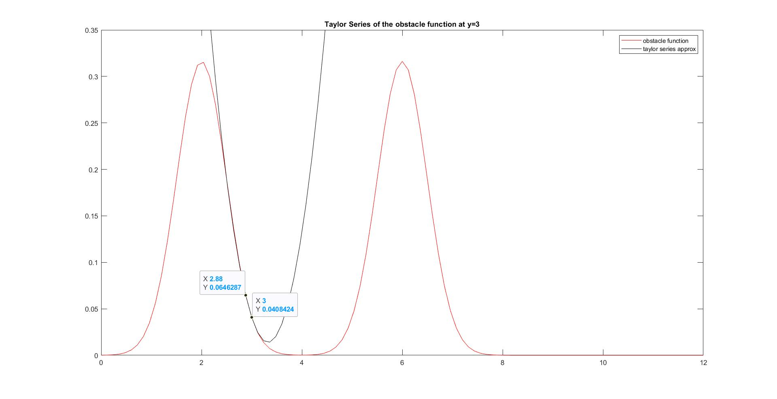

Slide 3
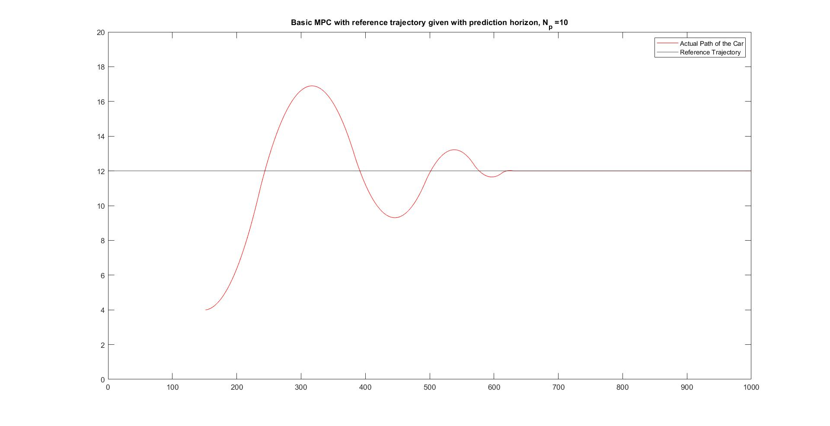

Slide 4
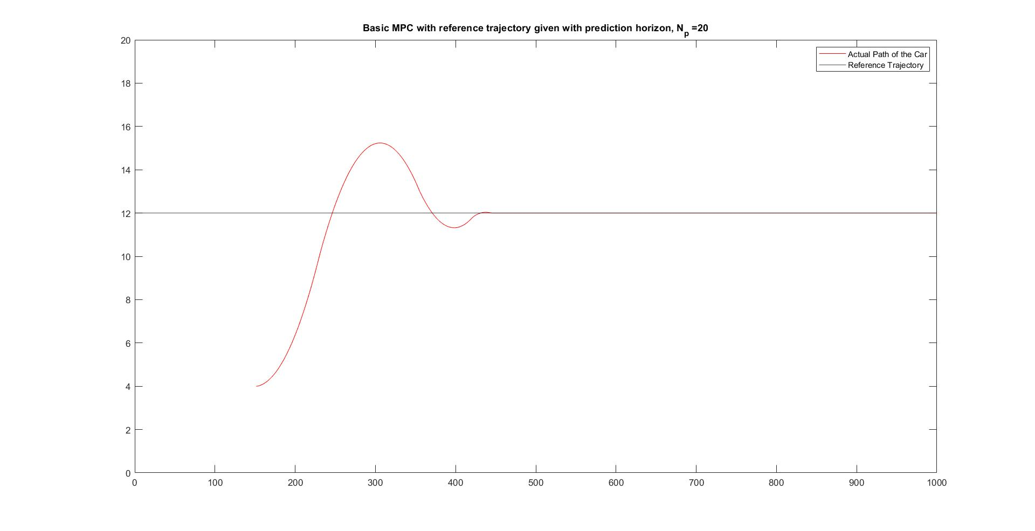

Slide 5
